Slide 1
Chapter Three
Budget Constraint
预算约束

Slide 2
Structure
Describe budget constraint
  Algebra
  Graph
Describe changes in budget constraint
Government programs and budget constraints
Non-linear budget lines

Slide 3
Consumption Sets
A consumption set （消费集）is the collection of all physically possible consumption bundles （消费束）to the consumer.

Slide 4
Consumption Bundle
A consumption bundle containing x₁ units of commodity 1, x₂ units of commodity 2 and so on up to x_{n} units of commodity n is denoted by the vector (x₁, x₂, … , x_{n}).

Slide 5
Physical Constraints
Non-negative:
Consumption set:
X={ (x₁, … , x_{n}) | x₁ ≥ 0, … , x_{n} ≥ 0 }
You only have 24 hours a day
Subsistence need
Etc.

Slide 6
Budget Constraint
What constrains consumption choice?
  Budgetary
  time
  other resource limitations.

Slide 7
Budget Constraints
Commodity prices are p₁, p₂, … , p_{n}.
Q: When is a bundle (x₁, … , x_{n}) affordable at prices p₁, … , p_{n}?
A: When
p₁x₁ + … + p_{n}x_{n} ≤ m
where m is the consumer’s (disposable) income.

Slide 8
Budget Constraints
The bundles that are only just affordable form the consumer’s budget constraint. This is the set
{ (x₁,…,x_{n}) | x₁ ≥ 0, …, x_{n} ≥ 0 and
p₁x₁ + … + p_{n}x_{n} = m }.

Slide 9
Budget Constraints
The consumer’s budget set （预算集）is the set of all affordable bundles;
B(p₁, … , p_{n}, m) =
{ (x₁, … , x_{n}) | x₁ ≥ 0, … , x_{n} ≥ 0 and
p₁x₁ + … + p_{n}x_{n} ≤ m }
The budget constraint is the upper boundary of the budget set.

Slide 10
Budget Set and Constraint for Two Commodities
x₂
Budget constraint is
p₁x₁ + p₂x₂ = m.
m /p₂
m /p₁
x₁

Slide 11
Budget Set and Constraint for Two Commodities
x₂
Budget constraint is
p₁x₁ + p₂x₂ = m.
m /p₂
m /p₁
x₁

Slide 12
Budget Set and Constraint for Two Commodities
x₂
Budget constraint is
p₁x₁ + p₂x₂ = m.
m /p₂
Just affordable
m /p₁
x₁

Slide 13
Budget Set and Constraint for Two Commodities
x₂
Budget constraint is
p₁x₁ + p₂x₂ = m.
m /p₂
Not affordable
Just affordable
m /p₁
x₁

Slide 14
Budget Set and Constraint for Two Commodities
x₂
Budget constraint is
p₁x₁ + p₂x₂ = m.
m /p₂
Not affordable
Just affordable
Affordable
m /p₁
x₁

Slide 15
Budget Set and Constraint for Two Commodities
x₂
Budget constraint is
p₁x₁ + p₂x₂ = m.
m /p₂
the collection
of all affordable bundles.
Budget
Set
m /p₁
x₁

Slide 16
Budget Set and Constraint for Two Commodities
x₂
p₁x₁ + p₂x₂ = m is
x₂ = -(p₁/p₂)x₁ + m/p₂
so slope is -p₁/p₂.
m /p₂
Budget
Set
m /p₁
x₁

Slide 17

Meaning of the Slope
Increasing x₁ by 1 must reduce x₂ by p₁/p_{2.}
Opportunity cost of consuming x₁
Or, the rate of exchange that market allows.

Slide 18
Budget Constraints
x₂
Slope is -p₁/p₂
-p₁/p₂
+1
x₁

Slide 19
Budget Constraints
x₂
Opp. cost of an extra unit of
commodity 1 is p₁/p₂ units
foregone of commodity 2.
-p₁/p₂
+1
x₁

Slide 20
Budget Constraints
x₂
Opp. cost of an extra unit of
commodity 1 is p₁/p₂ units
foregone of commodity 2.
Opp. cost of an extra
unit of commodity 2 is
p₂/p₁ units foregone
of commodity 1.
+1
-p₂/p₁
x₁

Slide 21
Budget Sets & Constraints; Income and Price Changes
The budget constraint and budget set depend upon prices and income. What happens as prices or income change?

Slide 22
How do the budget set and budget constraint change as income m increases?
x₂
Original
budget set
x₁

Slide 23
Higher income gives more choice
x₂
New affordable consumption
choices
Original and
new budget
constraints are
parallel (same
slope).
Original
budget set
x₁

Slide 24
How do the budget set and budget constraint change as income m decreases?
x₂
Original
budget set
x₁

Slide 25
How do the budget set and budget constraint change as income m decreases?
x₂
Consumption bundles
that are no longer
affordable.
Old and new
constraints
are parallel.
New, smaller
budget set
x₁

Slide 26
Budget Constraints - Income Changes
Increases in income m shift the constraint outward in a parallel manner, thereby enlarging the budget set and improving choice.
Decreases in income m shift the constraint inward in a parallel manner, thereby shrinking the budget set and reducing choice.

Slide 27
Budget Constraints - Income Changes
No original choice is lost and new choices are added when income increases, so higher income cannot make a consumer worse off.
An income decrease may (typically will) make the consumer worse off.

Slide 28
Budget Constraints - Price Changes
What happens if just one price decreases?
Suppose p₁ decreases.

Slide 29
How do the budget set and budget constraint change as p₁ decreases from p₁’ to p₁”?
x₂
m/p₂
-p₁’/p₂
Original
budget set
m/p₁’
m/p₁”
x₁

Slide 30
How do the budget set and budget constraint change as p₁ decreases from p₁’ to p₁”?
x₂
m/p₂
New affordable choices
-p₁’/p₂
Original
budget set
m/p₁’
m/p₁”
x₁

Slide 31
How do the budget set and budget constraint change as p₁ decreases from p₁’ to p₁”?
x₂
m/p₂
New affordable choices
Budget constraint
pivots; slope flattens
from -p₁’/p₂ to
-p₁”/p₂
-p₁’/p₂
Original
budget set
-p₁”/p₂
m/p₁’
m/p₁”
x₁

Slide 32
Budget Constraints - Price Changes
Reducing the price of one commodity pivots the constraint outward. No old choice is lost and new choices are added, so reducing one price cannot make the consumer worse off.

Slide 33
Budget Constraints - Price Changes
Similarly, increasing one price pivots the constraint inwards, reduces choice and may (typically will) make the consumer worse off.

Slide 34
Uniform Ad Valorem Sales Taxes
An ad valorem sales tax （从价营业税）levied at a rate of 5% increases all prices by 5%, from p to (1+0.05)p = 1.05p.
An ad valorem sales tax levied at a rate of t increases all prices by tp from p to (1+t)p.
A uniform sales tax is applied uniformly to all commodities.

Slide 35
Uniform Ad Valorem Sales Taxes
A uniform sales tax levied at rate t changes the constraint from
p₁x₁ + p₂x₂ = m
to
(1+t)p₁x₁ + (1+t)p₂x₂ = m

Slide 36
Uniform Ad Valorem Sales Taxes
A uniform sales tax levied at rate t changes the constraint from
p₁x₁ + p₂x₂ = m
to
(1+t)p₁x₁ + (1+t)p₂x₂ = m
i.e.
p₁x₁ + p₂x₂ = m/(1+t).

Slide 37
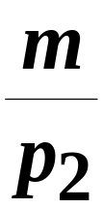
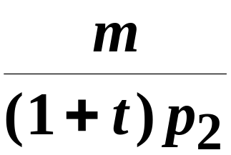
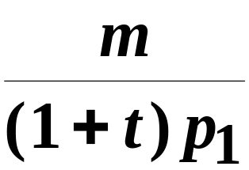

Uniform Ad Valorem Sales Taxes
x₂
p₁x₁ + p₂x₂ = m
p₁x₁ + p₂x₂ = m/(1+t)
x₁

Slide 38
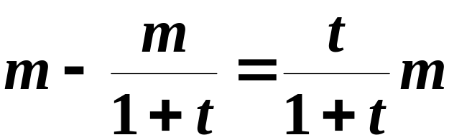
Uniform Ad Valorem Sales Taxes
x₂
Equivalent income loss
is
x₁

Slide 39
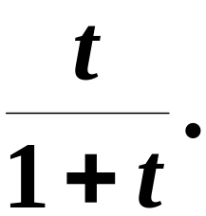
Uniform Ad Valorem Sales Taxes
x₂
A uniform ad valorem
sales tax levied at rate t
is equivalent to an income
tax levied at rate
x₁

Slide 40
The Food Stamp Program
Food stamps are coupons that can be legally exchanged only for food.
How does a commodity-specific gift such as a food stamp alter a family’s budget constraint?

Slide 41
The Food Stamp Program
Suppose m = $100, p_{F} = $1 and the price of “other goods” is p_{G} = $1.
“Other goods” is a composite good (复合商品)
  It simplifies the analysis to a 2-good model.
The budget constraint is then
F + G =100.

Slide 42
The Food Stamp Program
G
F + G = 100: before stamps.
100
100
F

Slide 43
The Food Stamp Program
G
F + G = 100: before stamps.
100
Budget set after 40 food
stamps issued.
40
100
140
F
(F-40) + G = 100 for F≥40
G=100 for F<40

Slide 44
The Food Stamp Program
G
F + G = 100: before stamps.
100
Budget set after 40 food
stamps issued.
The family’s budget
set is enlarged.
40
100
140
F
(F-40) + G = 100 for F≥40
G=100 for F<40

Slide 45
The Food Stamp Program
What if food stamps can be traded on a black market for $0.50 each?
F+G=100+0.5×(40-F) for F<40
(F-40)+G=100 for F ≥ 40

Slide 46
The Food Stamp Program
G
F + G = 100: before stamps.
120
Budget constraint after 40
food stamps issued.
100
Budget constraint with
black market trading.
40
100
140
F
F+G=100+0.5×(40-F) for F<40
(F-40)+G=100 for F ≥ 40

Slide 47
The Food Stamp Program
G
F + G = 100: before stamps.
120
Budget constraint after 40
food stamps issued.
100
Black market trading
makes the budget
set larger again.
40
100
140
F

Slide 48
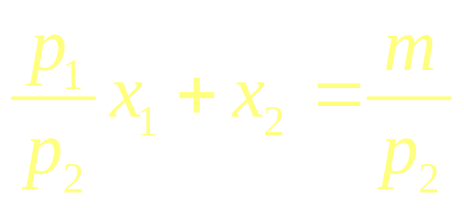
Budget Constraints - Relative Prices
“Numeraire” (记价物) means “unit of account”.
The budget line
p₁x₁ + p₂x₂ = m
Can be equivalently expressed as
Setting p₂=1 makes commodity 2 the numeraire and defines all prices relative to p₂;

Slide 49
Budget Constraints - Relative Prices
Any commodity can be chosen as the numeraire without changing the budget set or the budget constraint.
A relative price is the rates of exchange of commodities 2 for units of commodity 1.

Slide 50
Shapes of Budget Constraints
Q: What makes a budget constraint a straight line?
A: A straight line has a constant slope and the constraint is
p₁x₁ + … + p_{n}x_{n} = m
so if prices are constants then a constraint is a straight line.

Slide 51
Shapes of Budget Constraints
But what if prices are not constants?
E.g. bulk buying discounts, or price penalties for buying “too much”.
Then constraints will be curved.

Slide 52
Shapes of Budget Constraints - Quantity Discounts
Suppose p₂ is constant at $1 but that p₁=$2 for 0 ≤ x₁ ≤ 20 and p₁=$1 for x₁>20.

Slide 53
Shapes of Budget Constraints - Quantity Discounts
Suppose p₂ is constant at $1 but that p₁=$2 for 0 ≤ x₁ ≤ 20 and p₁=$1 for x₁>20.
Then the constraint’s slope is
- 2, for 0 ≤ x₁ ≤ 20
-p₁/p₂ =
- 1, for x₁ > 20
{

Slide 54
Shapes of Budget Constraints with a Quantity Discount
x₂
m = $100
100
Slope = - 2 / 1 = - 2
(p₁=2, p₂=1)
Slope = - 1/ 1 = - 1
(p₁=1, p₂=1)
20
50
80
x₁

Slide 55
Shapes of Budget Constraints with a Quantity Discount
x₂
m = $100
100
Slope = - 2 / 1 = - 2
(p₁=2, p₂=1)
Slope = - 1/ 1 = - 1
(p₁=1, p₂=1)
20
50
80
x₁

Slide 56
Budget Constraints with a Quantity Discount
The constraint is
2x₁+x₂=m for 0 ≤ x₁ ≤ 20
2×20+(x₁-20)+x₂=m for x₁ > 20
{

Slide 57
Shapes of Budget Constraints with a Quantity Discount
x₂
m = $100
100
Budget Constraint
Budget Set
20
50
80
x₁

Slide 58
Shapes of Budget Constraints with a Quantity Penalty
x₂
Budget Constraint
Budget Set
x₁

Slide 59
Shapes of Budget Constraints - One Price Negative
Commodity 1 is stinky garbage. You are paid $2 per unit to accept it; i.e. p₁ = - $2. p₂ = $1. Income, other than from accepting commodity 1, is m = $10.
Then the constraint is
- 2x₁ + x₂ = 10 or x₂ = 2x₁ + 10.

Slide 60
Shapes of Budget Constraints - One Price Negative
x₂
x₂ = 2x₁ + 10
Budget constraint’s slope is
-p₁/p₂ = -(-2)/1 = +2
10
x₁

Slide 61
Shapes of Budget Constraints - One Price Negative
x₂
Budget set is
all bundles for
which x₁ ≥ 0,
x₂ ≥ 0 and
x₂ ≤ 2x₁ + 10.
10
x₁

